Slide 1
Multicomponent project – timeline update
Laurianne Estrada, Jonathan A. Ouimet, Zhicheng Lu, Molly Dougher, Shammah Lilonfe, Alexander W. Dowling, William A. Phillip
3.10.24

Slide 2

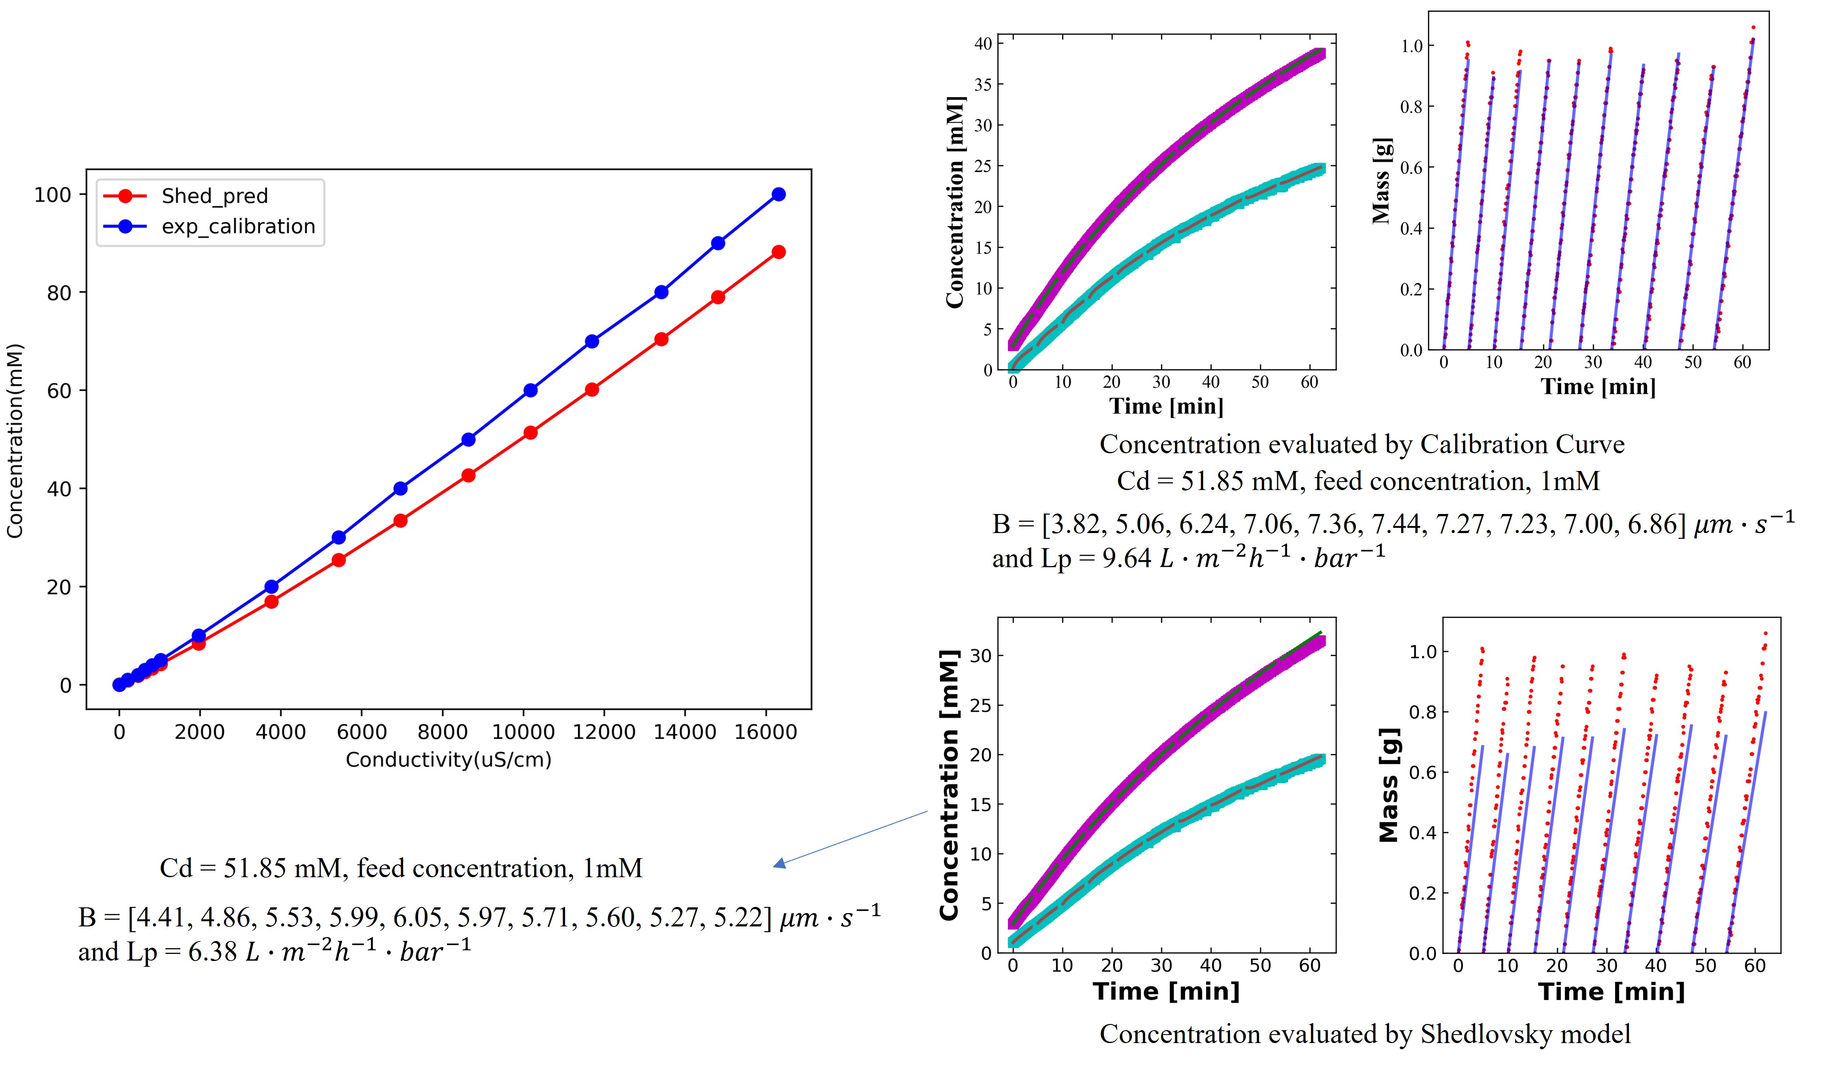
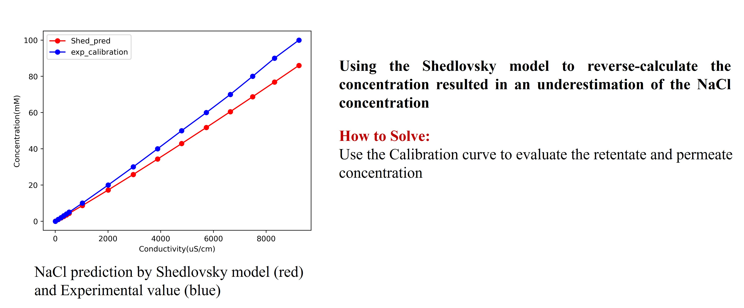
Multicomponent timeline progression: January and February
Zhicheng and Shammah:
Integrate the multisalt calibration curve into the DATA2 framework.
Run analysis for existing data.

Slide 3
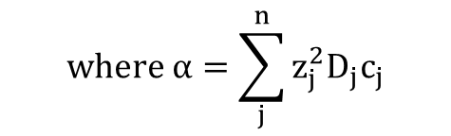
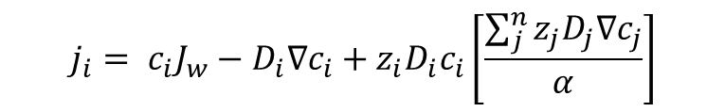
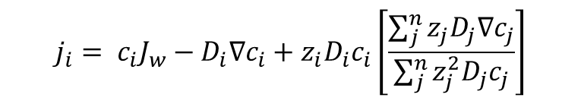
Multicomponent timeline progression: January and February
Laurianne and Molly:
Derive the solute flux equation considering diffusion, convection, and electromigration for multisalt systems.
Derive the equations for concentration polarization in multisalt systems.
$$j_{i}= c_{i}J_{w}−D_{i}∇c_{i}+z_{i}D_{i}c_{i}\left[\frac{\sum_{j}^{n}{z_{j}D_{j}∇c_{j}}}{\sum_{j}^{n}{z_{j}^{2}D_{j}c_{j}}}\right]$$
$$j_{i}= c_{i}J_{w}−D_{i}∇c_{i}+z_{i}D_{i}c_{i}\left[\frac{\sum_{j}^{n}{z_{j}D_{j}∇c_{j}}}{α}\right]$$
$$where α=\sum_{j}^{n}{z_{j}^{2}D_{j}c_{j}}$$
*Zhicheng and Molly integrate into coding format.

Slide 4
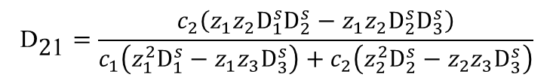



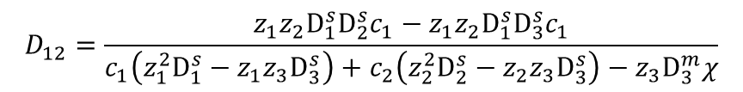
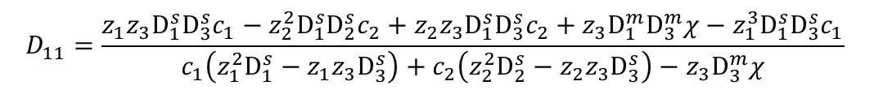
Multicomponent timeline progression: January and February
$$j_{1}= c_{1}J_{w}+D_{11}∇c_{1}+D_{12}∇c_{2}$$
$$j_{2}=c_{2}J_{w}+{\text{D}}_{\text{2}\text{1}}∇c_{1}+{\text{D}}_{\text{2}\text{2}}∇c_{2}$$
$$D_{11}=\frac{z_{1}z_{3}D_{1}^{s}D_{3}^{s}c_{1}−z_{2}^{2}D_{1}^{s}D_{2}^{s}c_{2}+z_{2}z_{3}D_{1}^{s}D_{3}^{s}c_{2}+z_{3}D_{1}^{m}D_{3}^{m}χ−z_{1}^{3}D_{1}^{s}D_{3}^{s}c_{1}}{c_{1}\left(z_{1}^{2}D_{1}^{s}−z_{1}z_{3}D_{3}^{s}\right)+c_{2}\left(z_{2}^{2}D_{2}^{s}−z_{2}z_{3}D_{3}^{s}\right)−z_{3}D_{3}^{m}χ}$$
$${\text{D}}_{\text{2}\text{1}}=\frac{c_{2}\left(z_{1}z_{2}D_{1}^{s}D_{2}^{s}−z_{1}z_{2}D_{2}^{s}D_{3}^{s}\right)}{c_{1}\left(z_{1}^{2}D_{1}^{s}−z_{1}z_{3}D_{3}^{s}\right)+c_{2}\left(z_{2}^{2}D_{2}^{s}−z_{2}z_{3}D_{3}^{s}\right)}$$
$$D_{12}=\frac{z_{1}z_{2}D_{1}^{s}D_{2}^{s}c_{1}−z_{1}z_{2}D_{1}^{s}D_{3}^{s}c_{1}}{c_{1}\left(z_{1}^{2}D_{1}^{s}−z_{1}z_{3}D_{3}^{s}\right)+c_{2}\left(z_{2}^{2}D_{2}^{s}−z_{2}z_{3}D_{3}^{s}\right)−z_{3}D_{3}^{m}χ}$$
${\text{D}}_{\text{22}}=\frac{c_{1}\left(z_{1}z_{3}D_{2}^{s}D_{3}^{s}{−z}_{1}^{2}{D_{1}^{s}D_{2}^{s}}_{1}\right)+c_{2}\left(z_{2}z_{3}D_{2}^{s}D_{3}^{s}−z_{2}^{2}D_{2}^{s}D_{3}^{s}\right)}{c_{1}\left(z_{1}^{2}D_{1}^{s}−z_{1}z_{3}D_{3}^{s}\right)+c_{2}\left(z_{2}^{2}D_{2}^{s}−z_{2}z_{3}D_{3}^{s}\right)}$

Slide 5


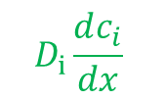

Multicomponent timeline progression: January and February
Laurianne and Molly:
Derive the equations for concentration polarization in multisalt systems.
Diffusive solute flux back into the bulk
cv
$$D_{i}\frac{dc_{i}}{dx}$$
$${J_{s}=J}_{w}c_{i,p}$$
Solute flux through the membrane
$$J_{w}c_{p,1}$$
Convective flux of solute towards the membrane
$$δ$$

Slide 6





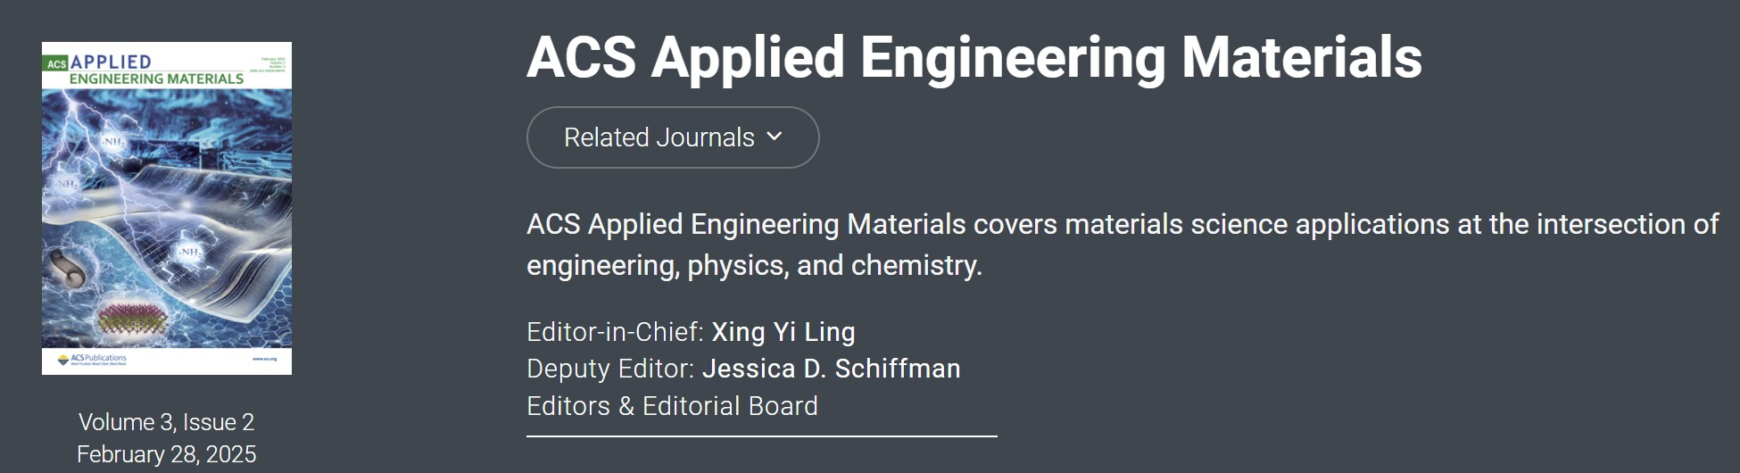
Multicomponent timeline progression: March and April
Identify which journal to publish in.
Begin outlining the method, materials, and introduction sections.
Zhicheng:
Integrate the multicomponent derivations into the DATA2 framework.
Compile the model selection results using AIC. Identify conditions for a 3-salt experiment.

Slide 7
Multicomponent timeline progression: May and June
Laurianne:
Execute remaining diafiltration experiments (duplicates, 3-salt system, informed by MBDoE).
Laurianne and Zhicheng:
Analyze remaining experiments (duplicates, 3-salt system).
Create manuscript figures and begin outlining the results and discussion sections.

